Slide 2
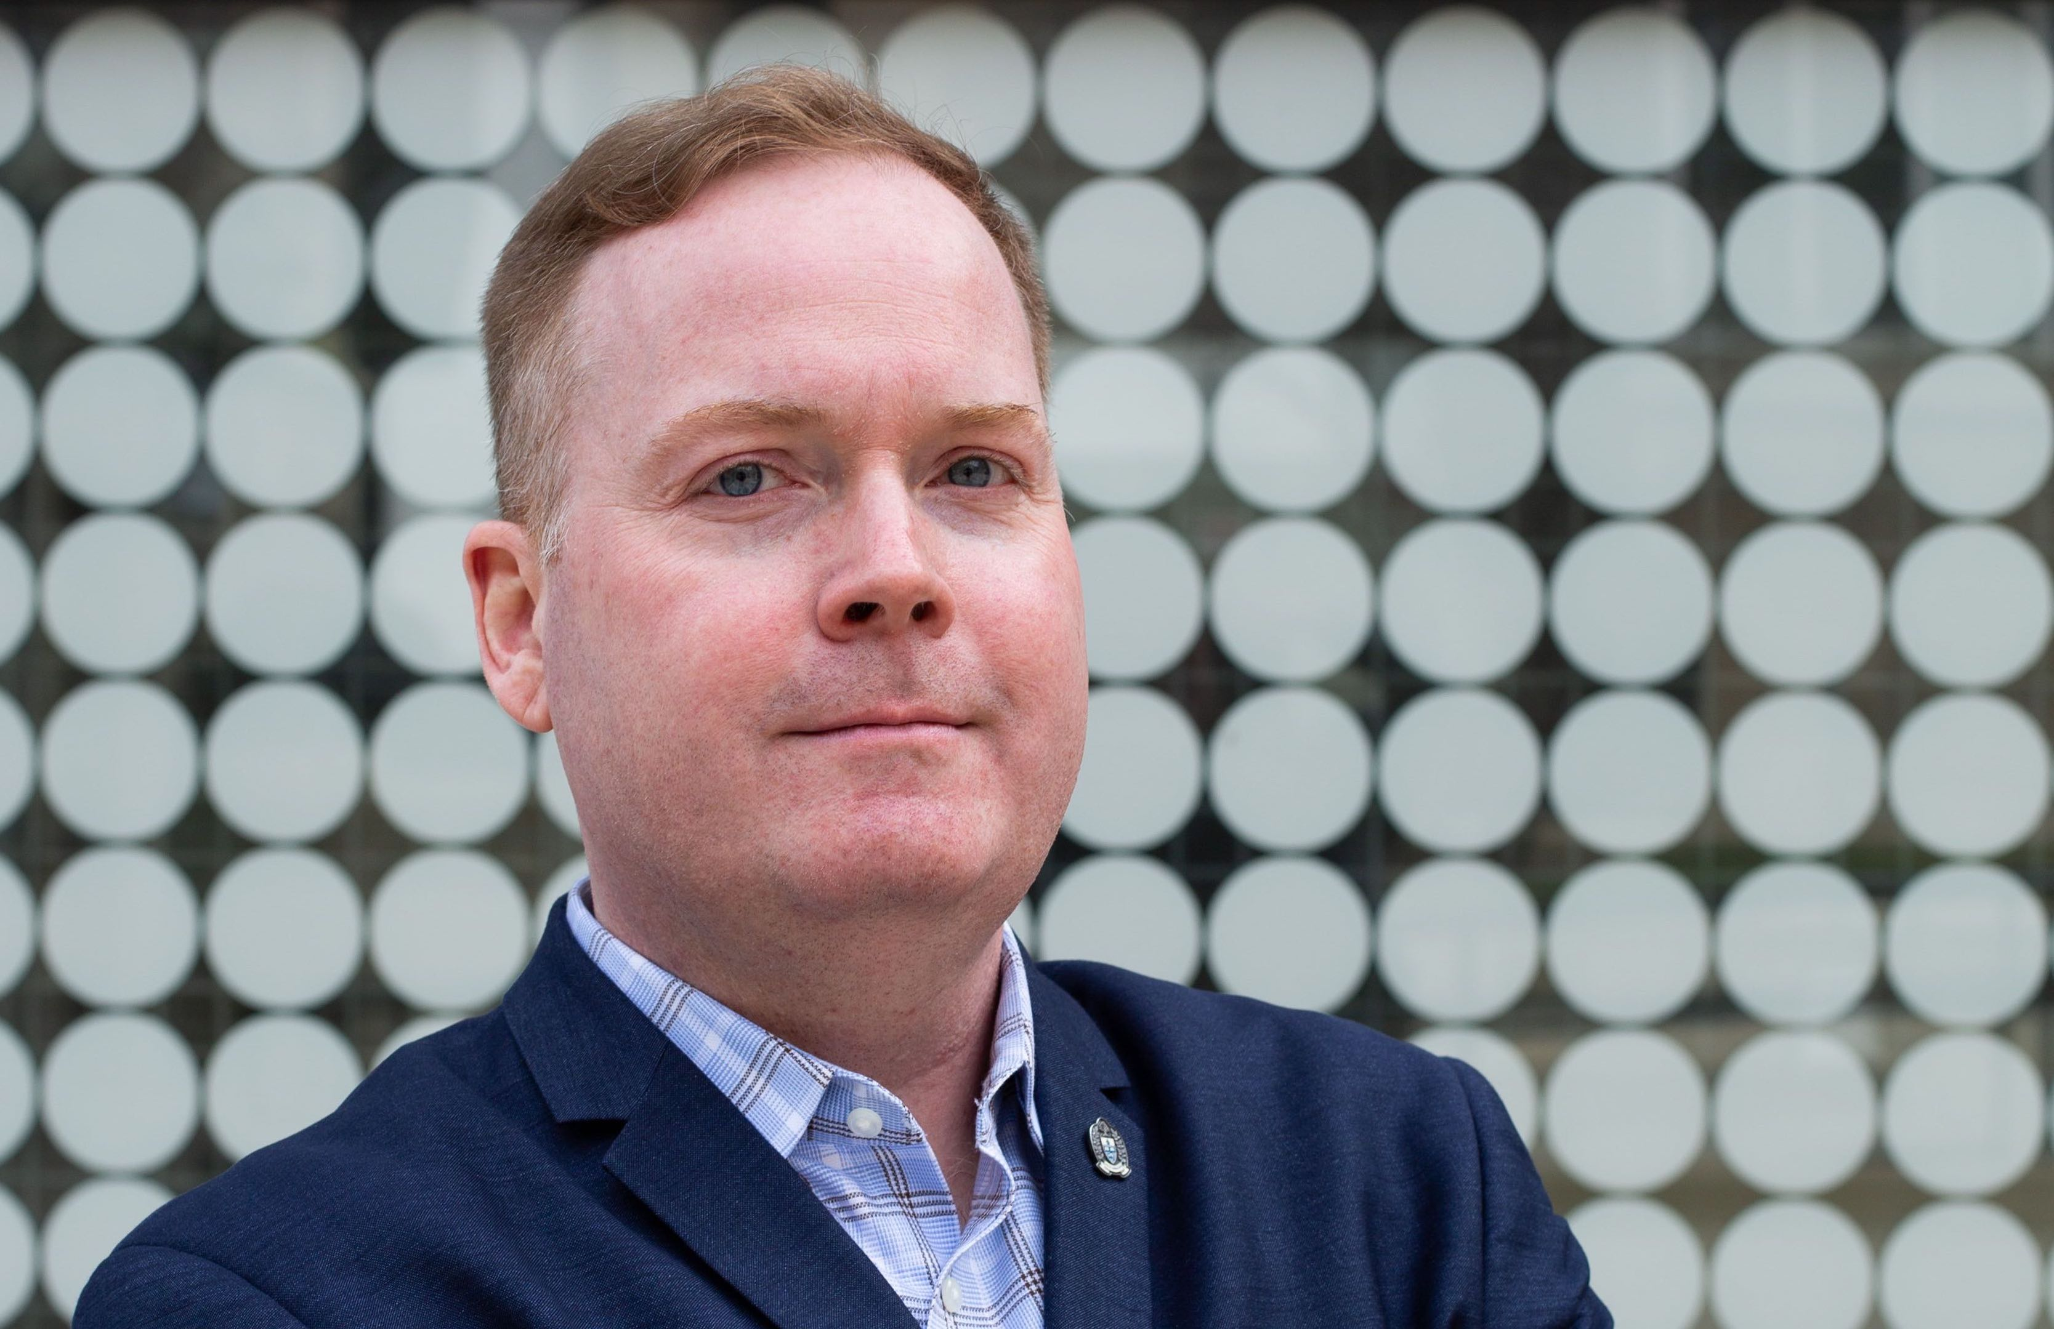
Liam Mitchell | @UofTMed_LIAM
So you’ve created a strat plan, now what?

Slide 3

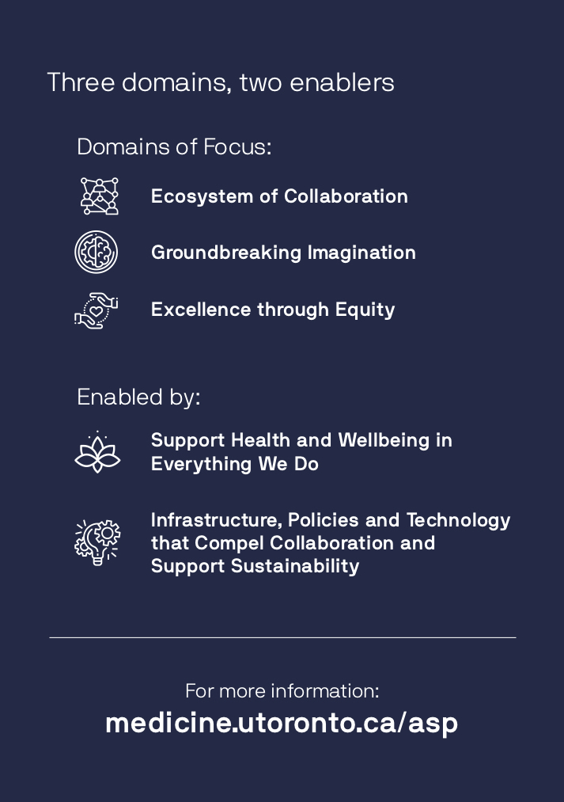

Print
Full Plan
Summary Postcard

Slide 4


Digital
E-Blast in January 2019
Website

Slide 5


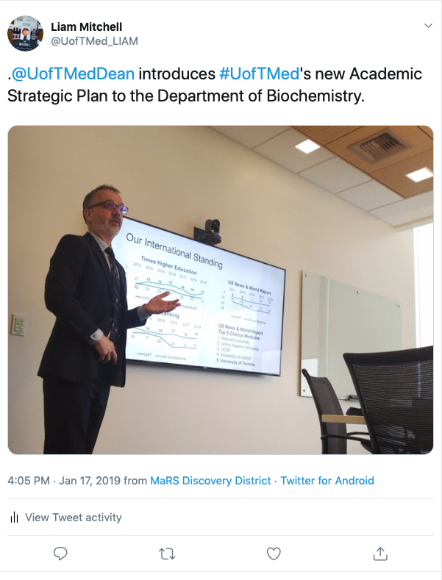
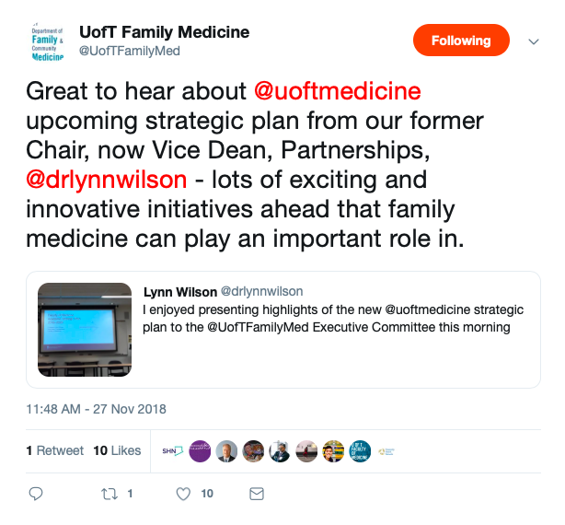
Personal Engagement

Slide 6
This vision will be realized through action in five areas:
3 Strategic Domains of Focus:
Ecosystem of Collaboration
Groundbreaking Imagination
Excellence
through Equity
Everything we do will set us up for exponential impact that draws on the diverse voices in our unparalleled research, learning and clinical network.
We will cultivate and bring to life ideas that impact scholarship and society.
Our environment will draw in and draw on our global outlook through diverse perspectives from a range of disciplines. Our graduates will be internationally recognized and a change force for equity.
2 Enablers to Support these Domains:
Support Health and Wellbeing
in Everything We Do
Infrastructure, Policies and Technology that Compel Collaboration and Support Sustainability

