Slide 2
Gillian Mathurin Munk School of Global Affairs & Public Policy

Slide 3
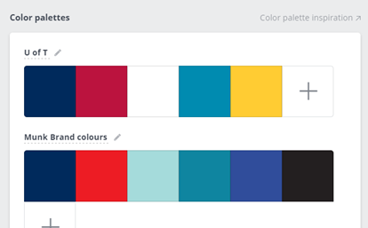
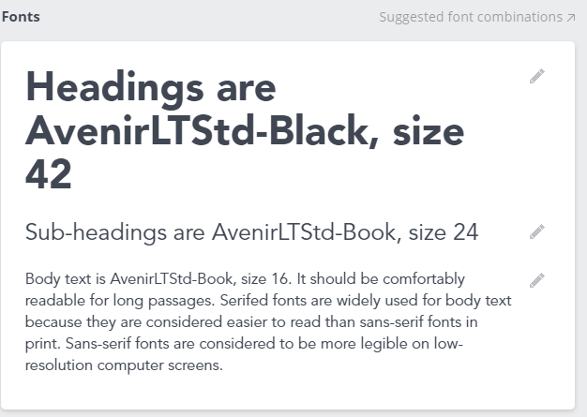
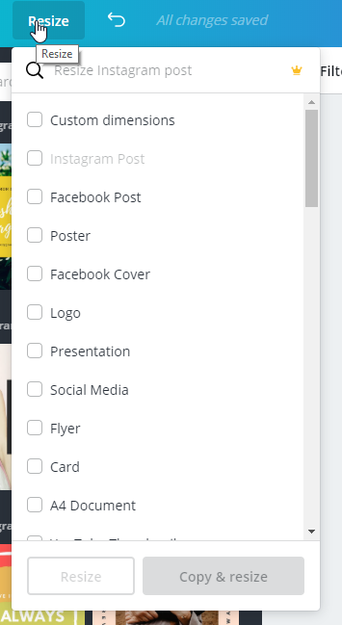
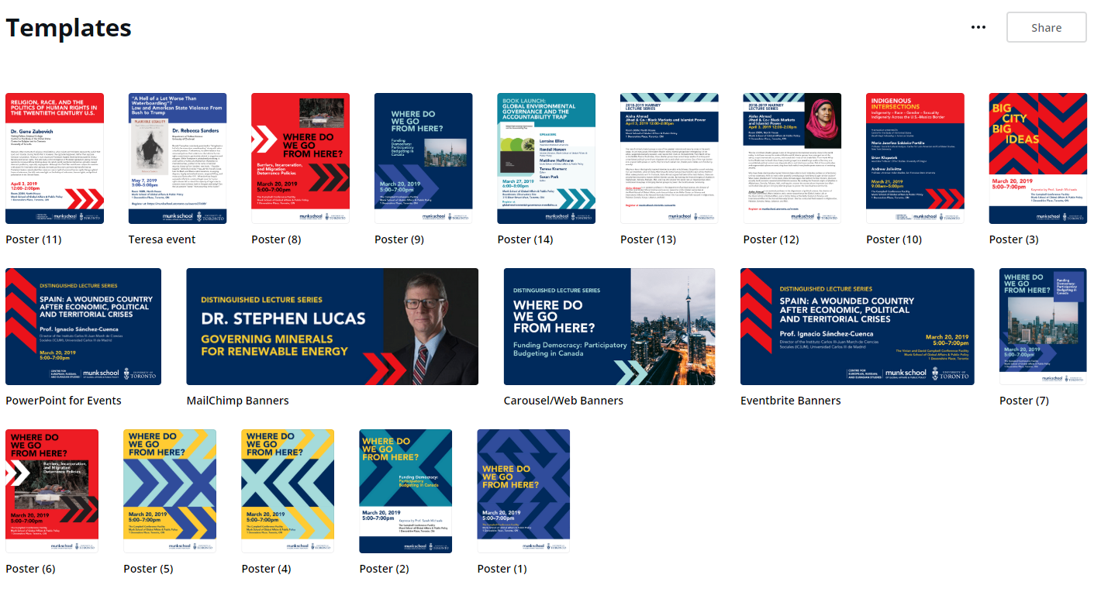
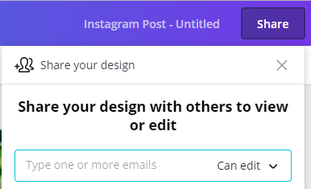
Using Canva for Work
Pre-load branding kit
Templates/designs
Add team members
‘Magic resize’
Stock images
Share designs
Download & print
Connect to social
Animation

