Slide 2
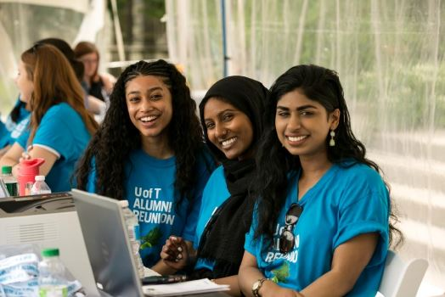
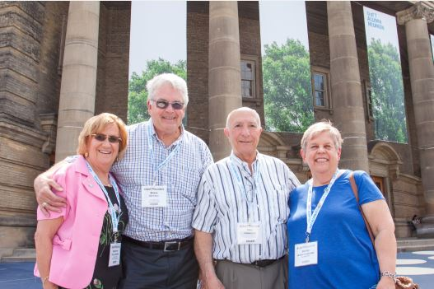
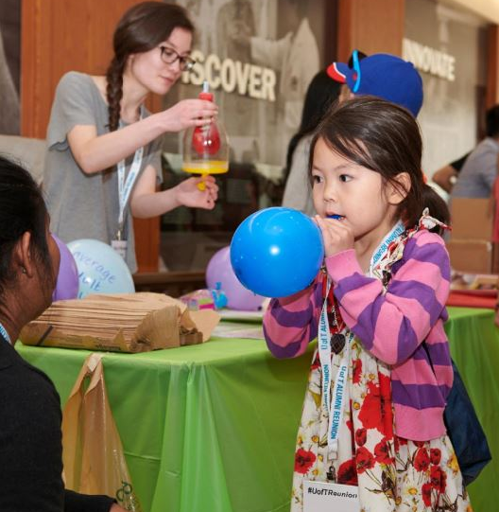
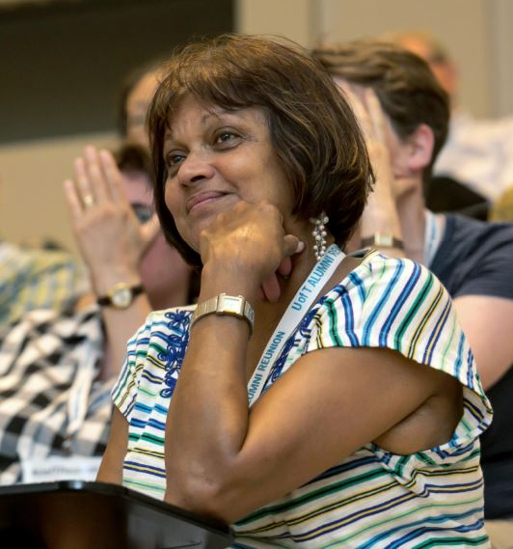
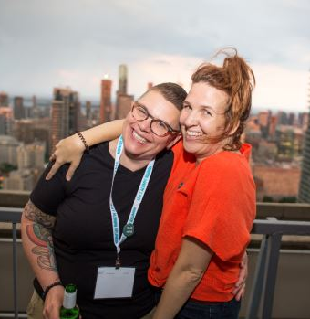
Alumni Reunion
Rebranding the University’s signature alumni event
Presented by:
Rachel Chochinov
Integrated Marketing Communications Manager
Advancement Communications & Marketing
Kimberly Lyn
Digital Editor and Community Manager
Advancement Communications & Marketing
Notes:
RC
Alumni Reunion, formerly known as Spring Reunion, is the University’s signature alumni event
Reunion has been part of the alumni experience for decades and continues to grow and realize greater success each year
Today, there are more than 130 events hosted by divisions and centrally geared towards different segments of our alumni community

Slide 3
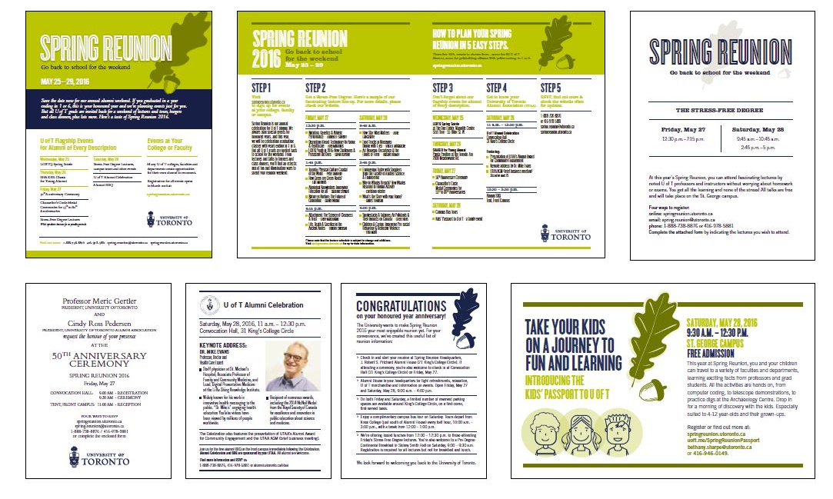
The Opportunity
Build on the success of Spring Reunion to develop a fully integrated experience rooted in the alumni engagement value proposition and the Boundless brand.
Alumni Relations Rebrand
Spring Reunion
Notes:
RC
The brief was to:
Reinvigorate this already successful event
Create an unforgettable experiences or our alumni
Align Spring Reunion with the Boundless brand platform
The Boundless brand had already been rolled out for other alumni programming (left); Spring Reunion was useful for 5-7 years; time for a refresh and new visual identity
The rebranding of Spring Reunion was an optimal moment to choose a name that better reflects the nature of the event. Alumni Reunion shifts the emphasis from the season to our alumni community.

Slide 4
Creative Idea
Our concept, So Many Beginnings, speaks to the transformative experiences of our university days—first times, eureka moments, and the special people and places that helped us discover who we are. It invites our alumni to revisit pivotal U of T moments, create new moments, and share their stories.
Notes:
RC
Creative approach born of the need to speak to the University’s 600,000 alumni
So Many Beginnings taps into the collective experience of having once been a student at the University
It invites alumni to celebrate important moments and firsts while coming back to campus for reunion weekend to create new memories
The concept seeks to generate a deeper, more emotive connection between alumni and the University

Slide 5
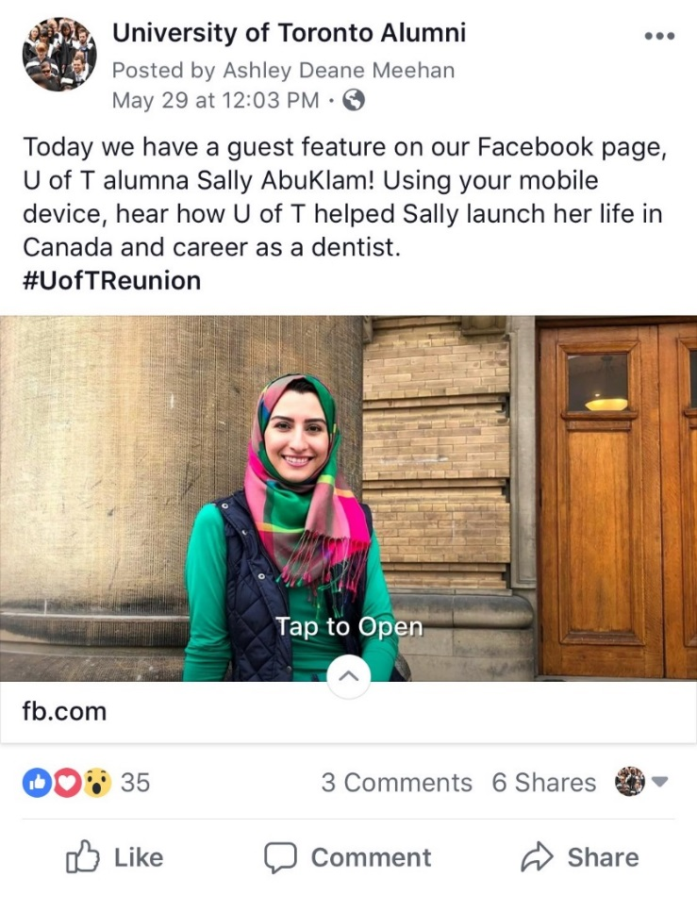
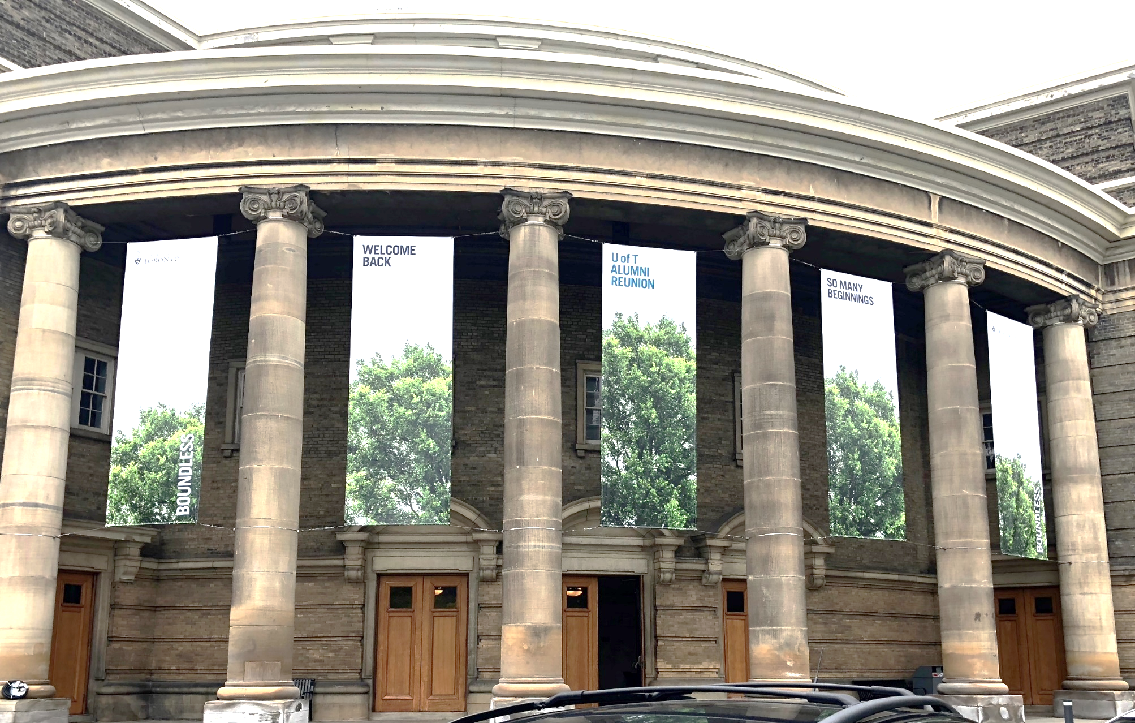
Implementation
Notes:
KL
To bring the So Many Beginnings concept to life, the team took an approach to tell the U of T alumni story – opting not to profile the University’s most famous or well-known graduates and instead, make real people the stars of the show
More than 40 alumni from 20+ divisions shared their stories in print, digital, social media and out of home formats becoming co-creators of marketing content rather than passive receivers of an institutional message
A multi-channel marketing and communications matrix guided all promotional activity leading up to and during reunion weekend:
Targeted email communications were sent to different segments of our alumni audiences
Alumni stories were featured on the Alumni Reunion microsite and social media channels
A series of videos were created to support pre-event promotion and drive registration
Dozens of poll banners featuring “real life” alumni took over King’s College Circle
Content was amplified through the University’s central digital communication channels
A robust and user-friendly digital toolkit was developed to support divisional colleagues
Stories and footage were collected at reunion to produce future campaign content

Slide 6
Results
Metric | 2017 | 2018 | % Change
Unique Registrants | 6,158 | 8,553 | +38.9%
Participating Divisions | 17 | 23 | +35.3%
Social Media (organic)
Reach | 281,881 | 262,261 | -6.96%
Impressions | 1,133,317 | 1,418,439 | +25.16%
Engagements | 14,763 | 17,464 | +18.13%
Paid Digital Advertising (Facebook and Google remarketing)
Impressions | - | 7,105,152 | HUGE increase! ;)
Clicks | - | 138,150 | HUGE increase! ;)
Email (central and divisional)
Click-through rate | 4.75% | 12.7% | +167.37%
Open rate | 30.10% | 35.13% | +16.71%
Web Sessions | 7,513 | 107,434 | +1329.97%
Video Views | 10,688 | 48,196 | +350.94%
Notes:
KL
Alumni Reunion was a smashing success from a consumer experience and marketing perspective
Registration: There was a 39% increase in registration compared to 2017
Divisional participation: We also saw an increase in divisional engagement and participation
Social media: Implemented new social media initiatives on the alumni channels to meet campaign objectives. For example, alumni takeover, Facebook Canvas and Instagram – and saw an increase in impressions and engagements.
Paid digital advertising– increase performance thanks to improved branding, help from an agency to monitor performance and optimize. New paid initiatives for the event such as LinkedIn Sponsored InMail, SnapChat filter and Google and Facebook remarketing.
Display advertising (Google ads) drove the most amount of traffic and gained a large number of impressions as expected.
Email (central and divisional) – saw a significantly increased open rate compared to last year and in comparison to industry benchmarks. This is due to improved email design, clearer calls to action in the emails and a strategically planned communications calendar. The excellent results are a clear validation of the creative and communications strategy.
Top performing emails from central (based on open and click through rate)
Central confirmation emails received the highest open rates spanning between 76-91%
LGBTQ+ Soirée invitations received the highest open and click through rates
Emails segmented by age: Encore alumni had a higher open and click through rate than established and young alumni
Web (sessions) – website improvements thanks to clearer site structure, functionality, branding and visuals. Paid digital advertising also contributed to increased results.
There was a large amount of traffic that came direct to the website. This shows individuals type in the URL which indicates that advertising (digital and print) dove a lot of traffic. Direct traffic also saw the largest number of conversions.
Video – six videos were developed or streamed during the campaign (3 alumni profiles and 3 Facebook Live broadcasts)

Slide 7
Key Learnings
Start with strategy aligned with clear business objectives
Understand your audience and the experience you want to offer
Engage the right internal and external partners
Champion integrated marketing and communications efforts
Leverage the strength of your community—celebrate real stories from real people
Measure, reflect and improve
Notes:
KL
Revamped Alumni Reunion was a strong expression of the University’s Boundless brand applied to a particular campaign
Its success showcased how the University can leverage the breadth and depth of our alumni community in a meaningful way

Slide 8
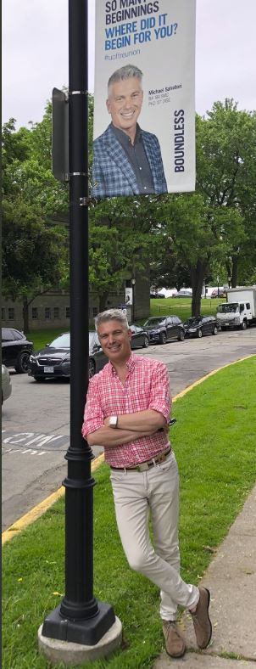
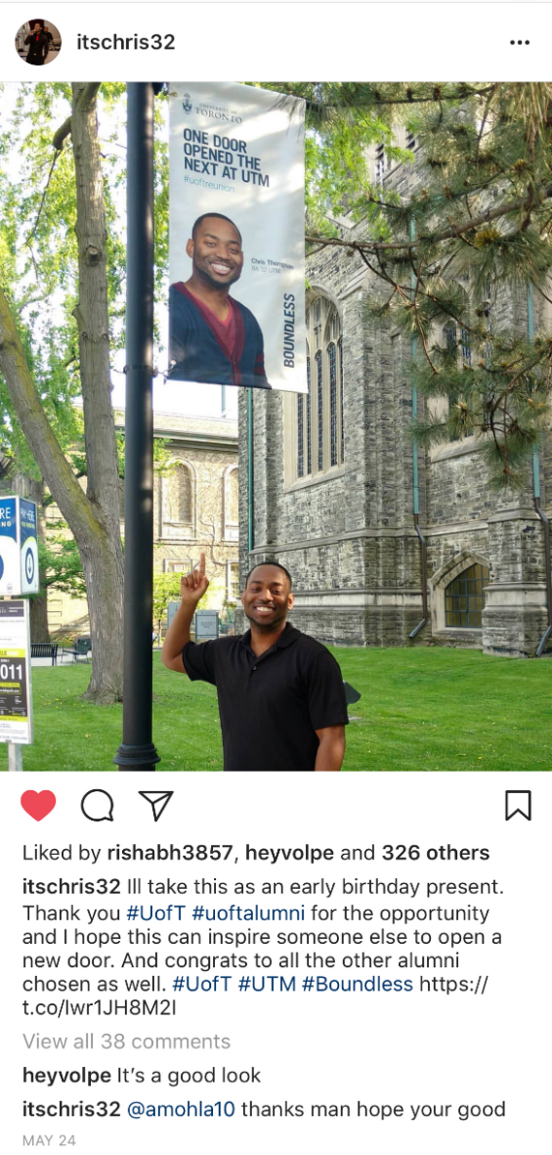
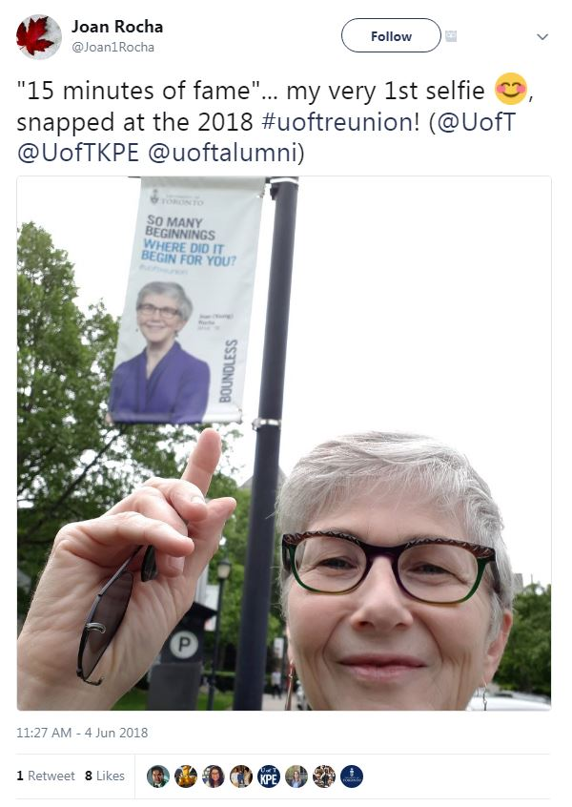
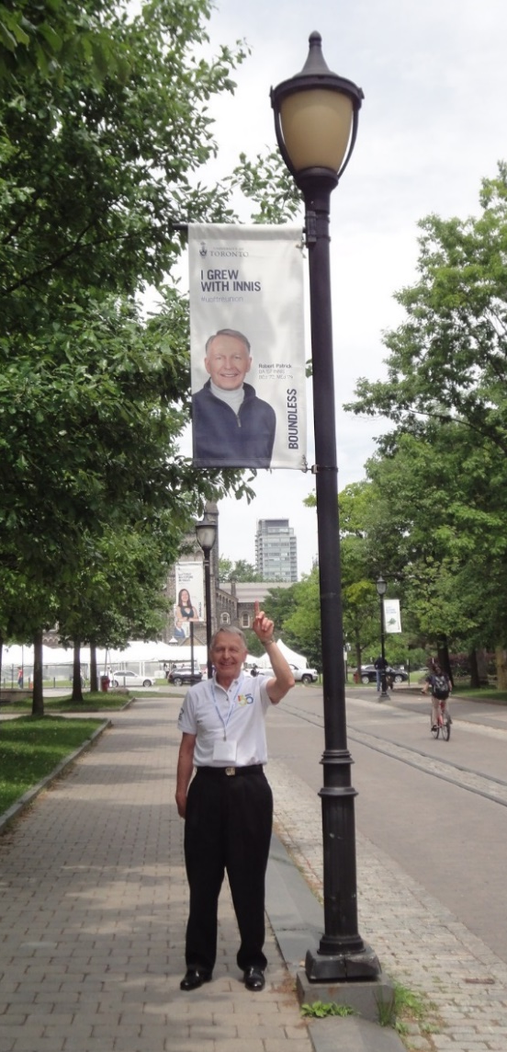
Thank you!
Notes:
KL

