Slide 2
Carla DeMarco Research Communications & Grants Manager (UTM)
Adventures in Podcasting

Slide 3
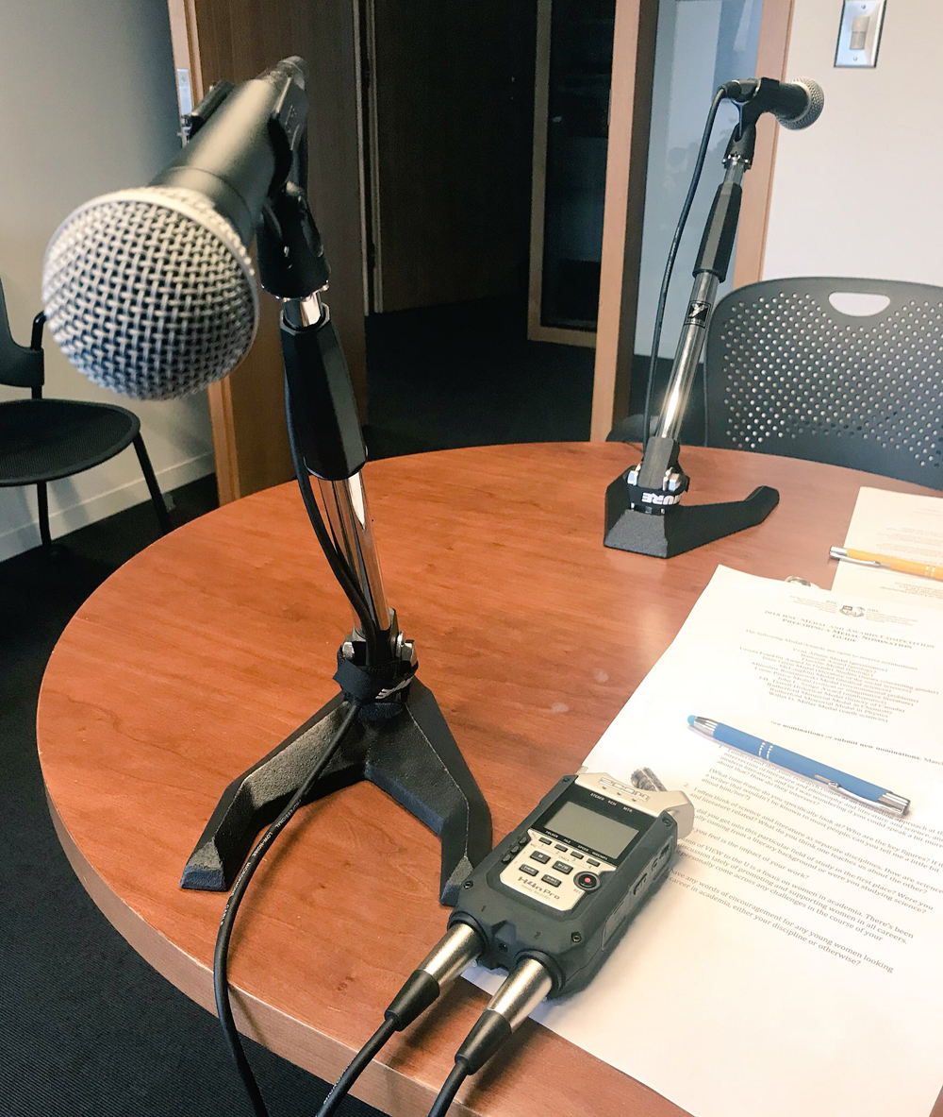
Adventures in Podcasting
Where it’s at: I’ve got no turntable and two microphones
About me
How this podcast came to be
Challenges to overcome

Slide 4
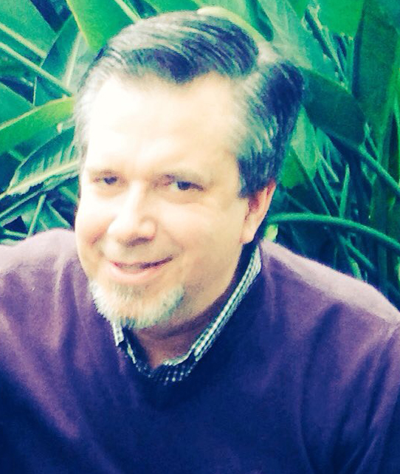
Adventures in Podcasting
About this podcast
The team
The silent partner

Slide 5
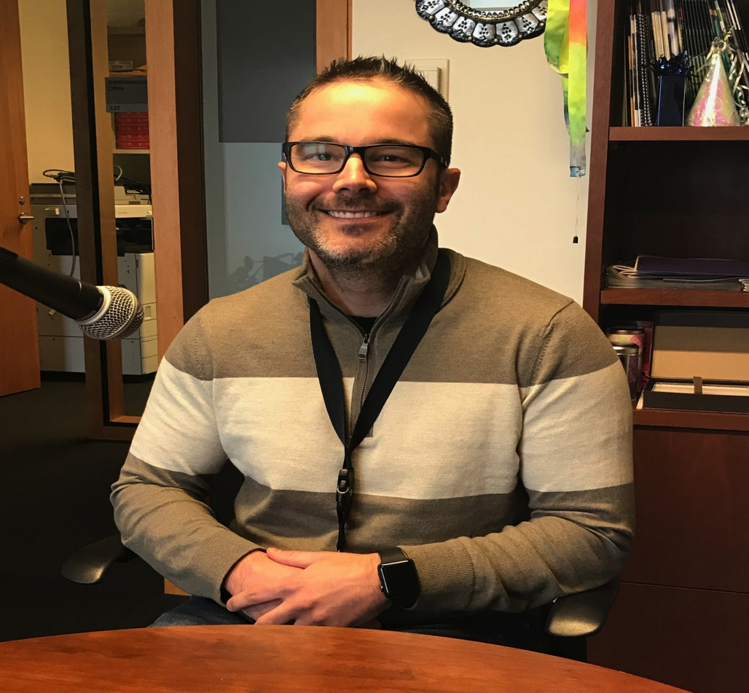
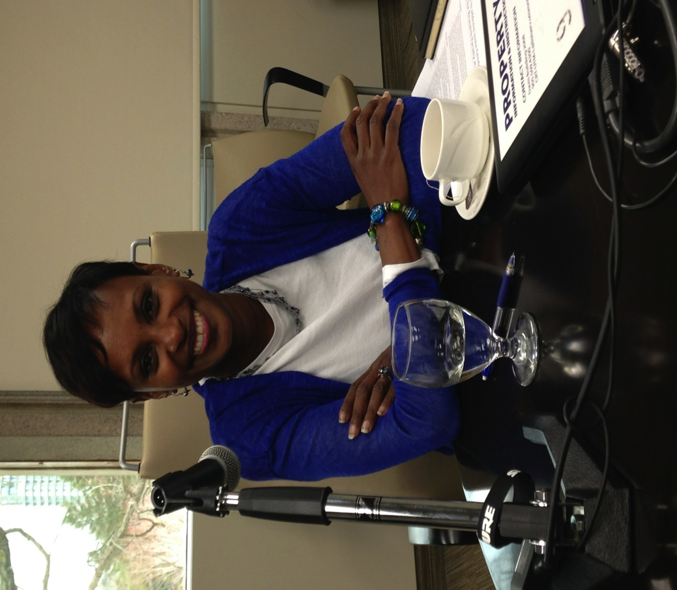
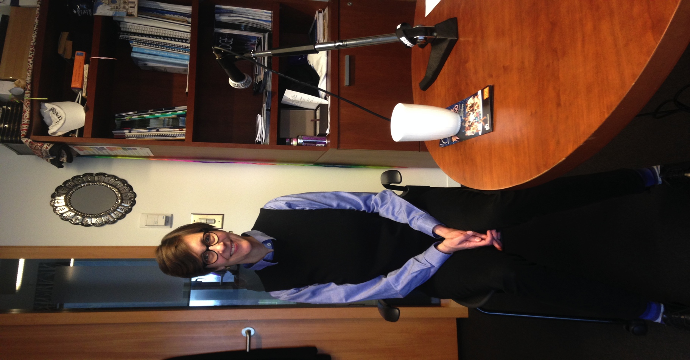
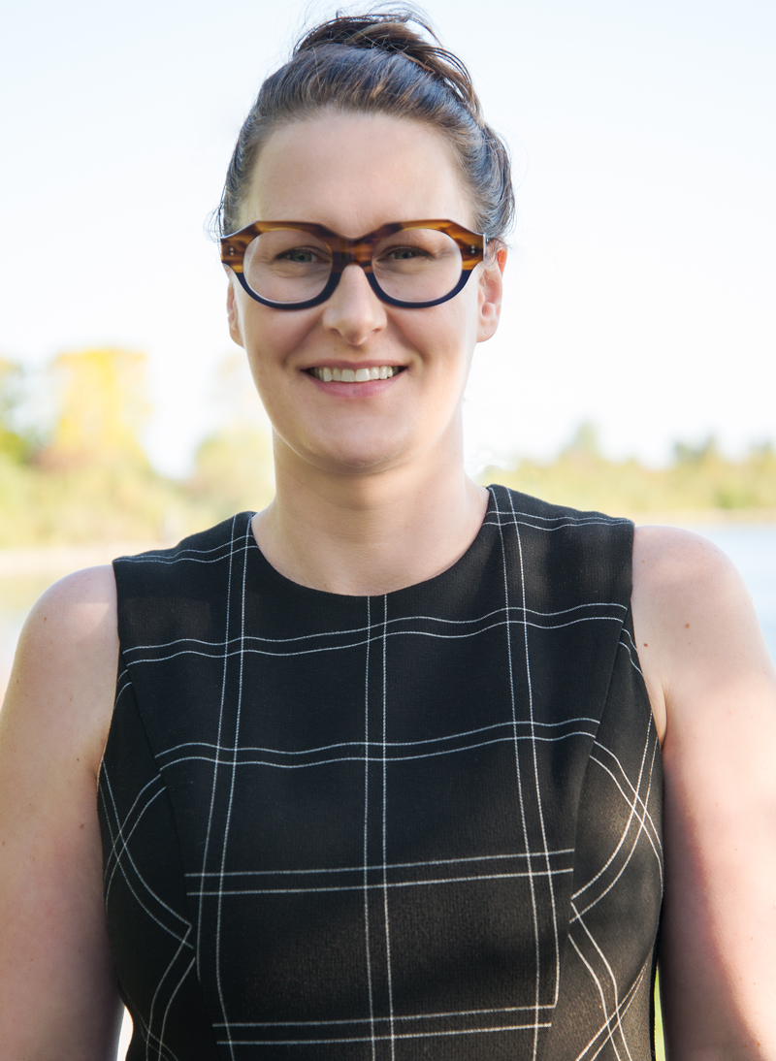
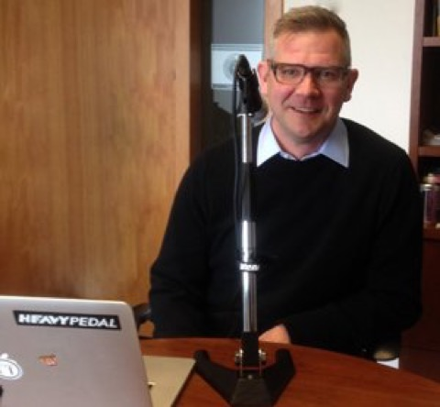
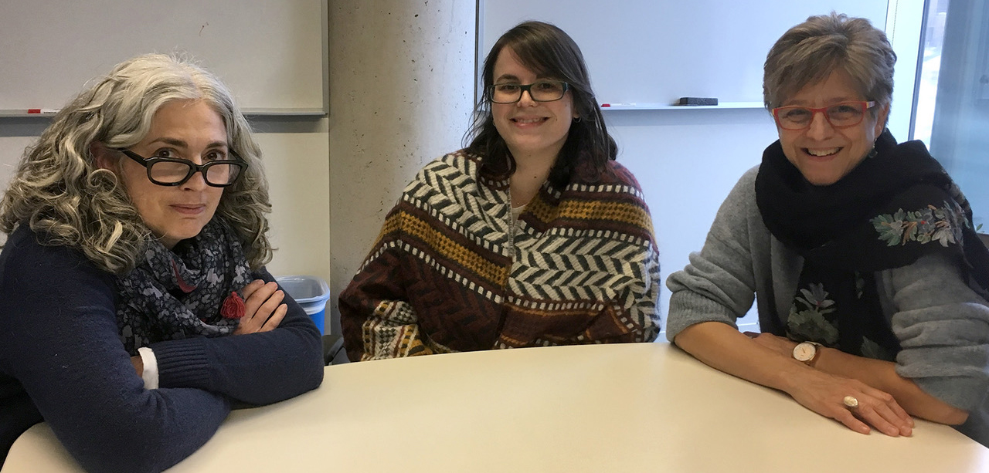
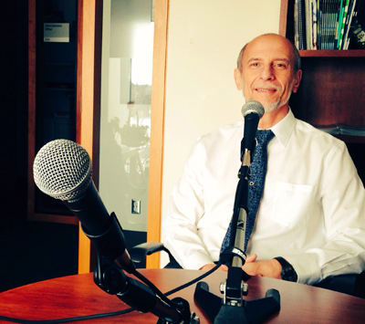
Adventures in Podcasting
Lessons learned (”anec-don’ts”)
Challenges
Outcomes (stats, etc.)

Slide 6
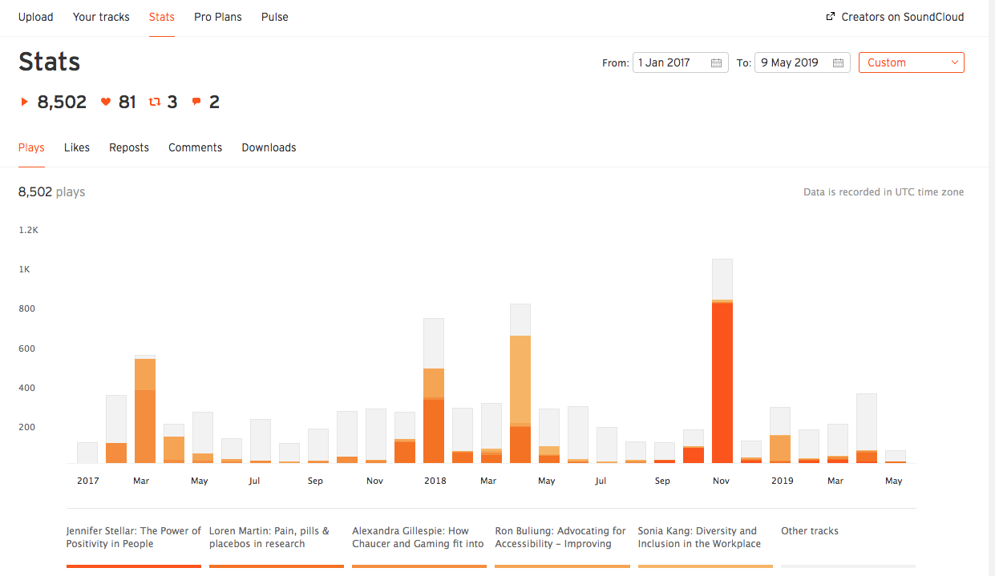
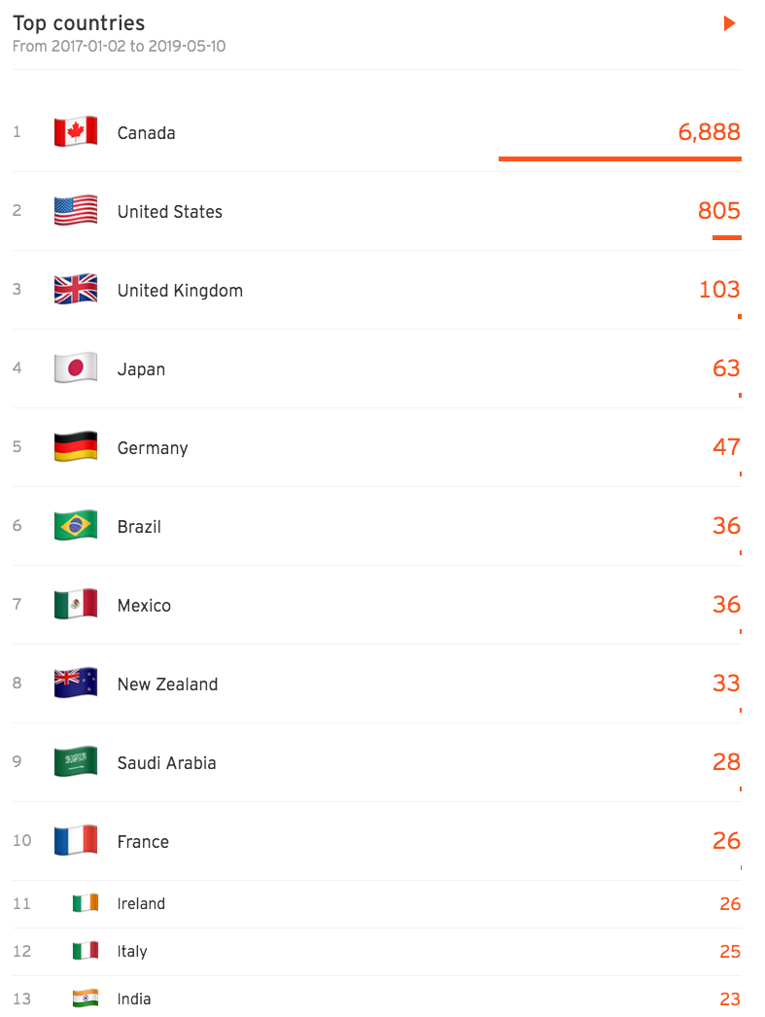
Adventures in Podcasting

Slide 7
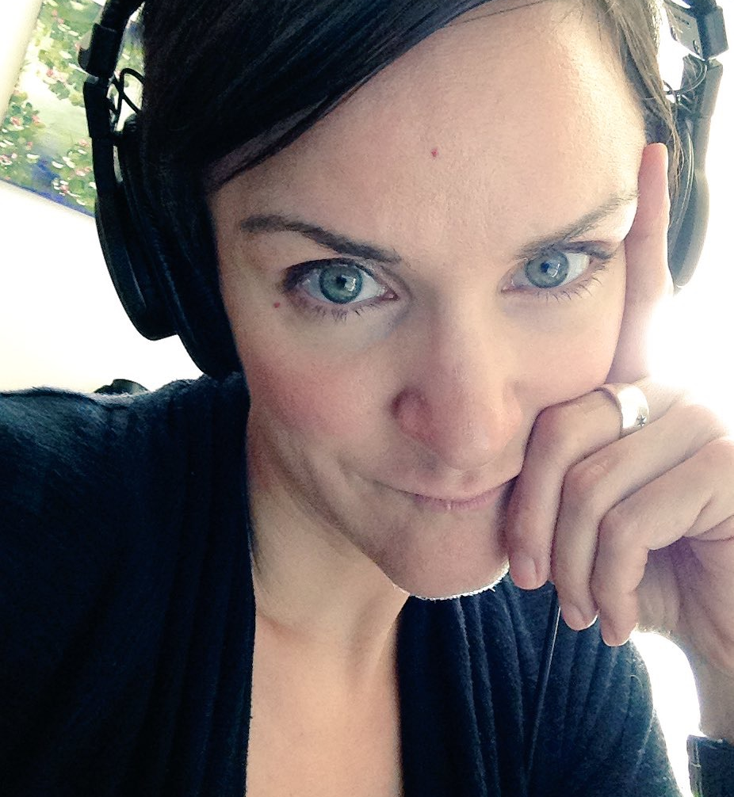
Adventures in Podcasting
“There is only one rule for being a good talker – learn to listen.”
− Christopher Morley American author

