Slide 1
Amanda Hacio
How to put together a 200 page, multi-stakeholder coffee table book

Slide 2
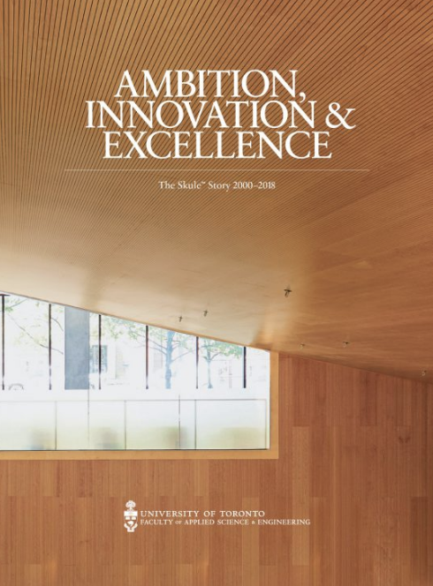
Key takeaways
Define a clear vision for the project early on
Define your target audience and determine the kind of content they like (i.e. engineers like charts and numbers)
Create a strategy for stakeholder engagement
Create a small committee with advisors who understand and are well connected with your key stakeholders
Consultation is king
When drafting the content, think about how you might repurpose it on digital platforms to give it another life (i.e. repurpose historical information and photos on your Faculty’s history page)
Choose vendors who know your audience and are willing to work with you as timelines and priorities shift
Build in an evaluation tool or mechanism to measure engagement and success of the project
Questions? amanda.hacio@utoronto.ca
Find a digital copy of the book at www.engineering.utoronto.ca/history

