Slide 2
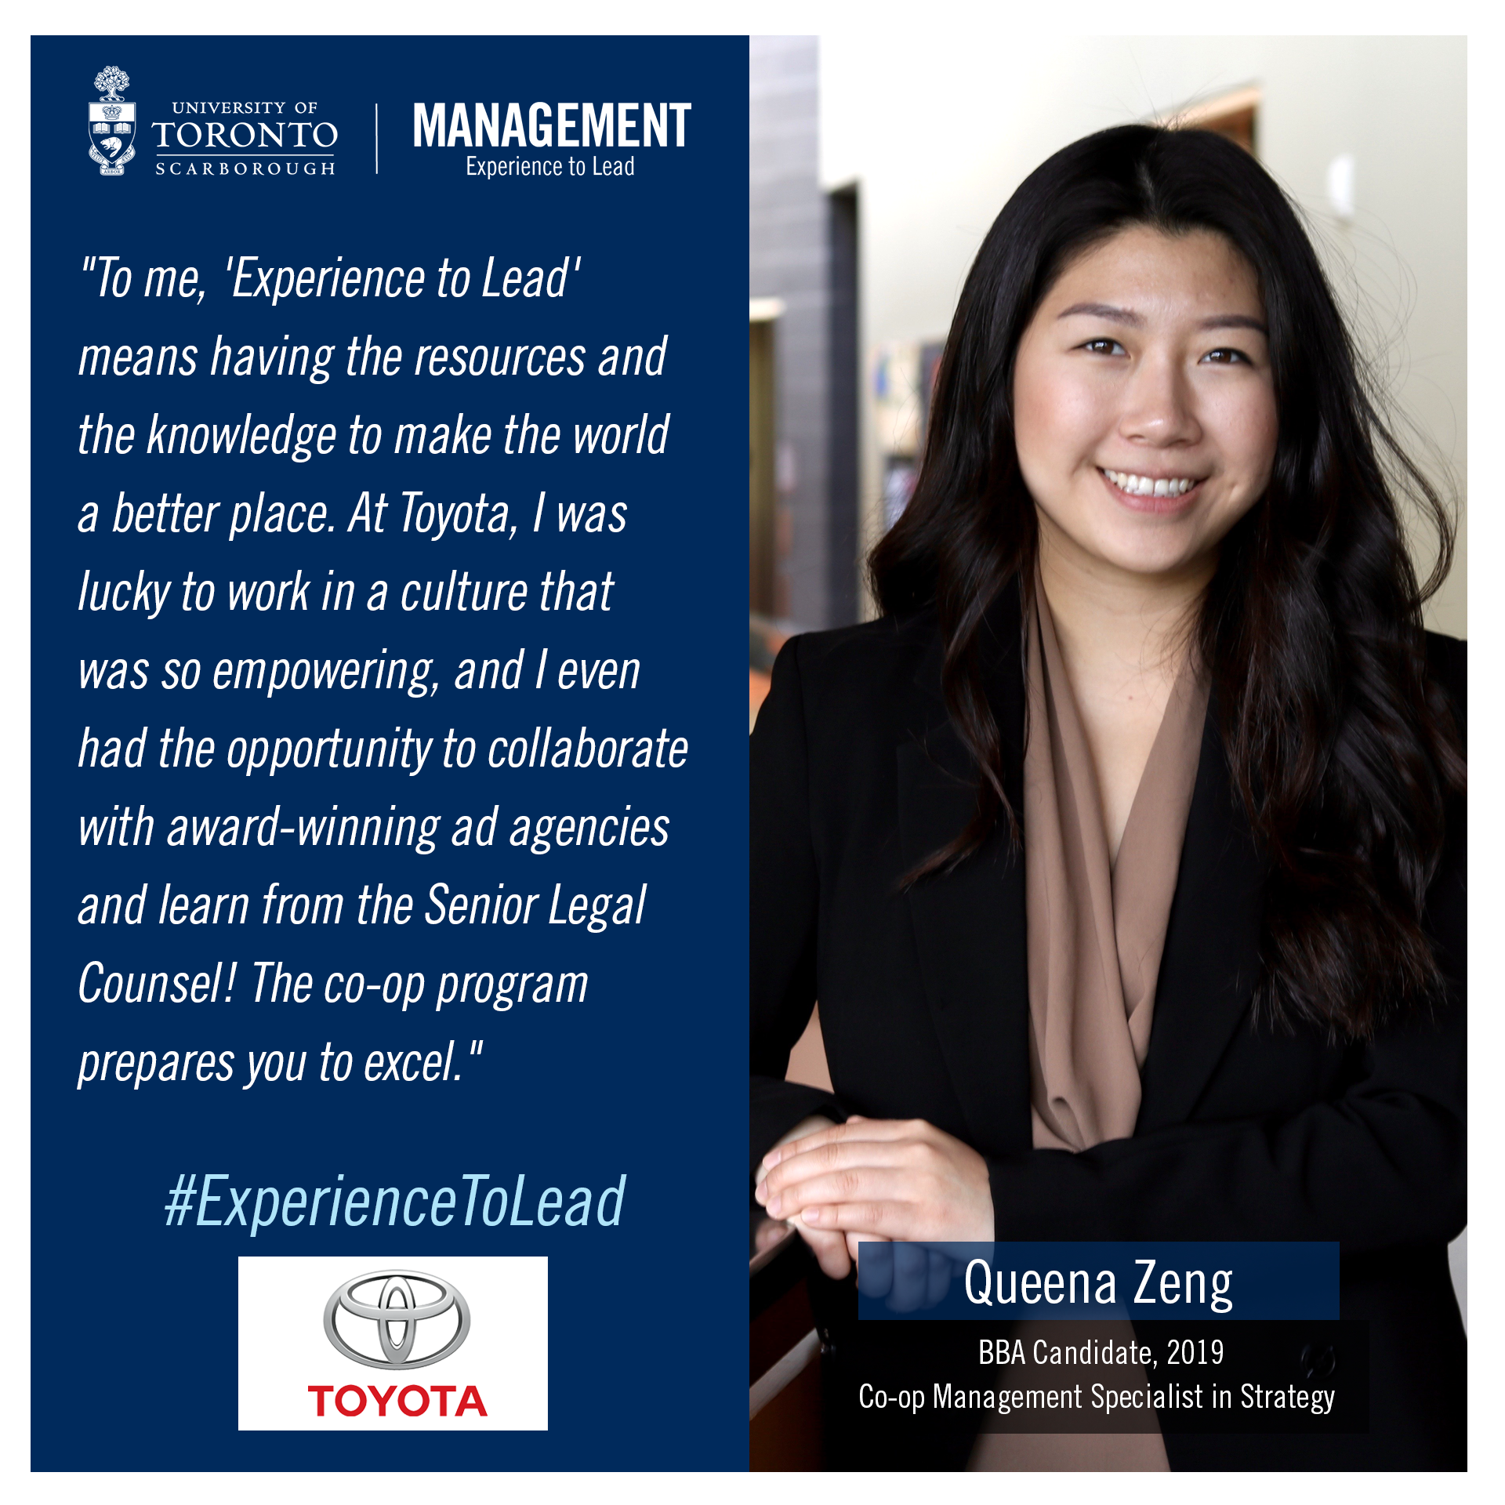
FOLLOW @UTSCMGMT ON INSTAGRAM

